Slide 1
Virginia Association of School Superintendents
Covid-19 Vaccination
Guidelines for Employers
R. Craig Wood
Micah Schwartz
January 14, 2021

Slide 2
Speakers
R. Craig Wood, McGuireWoods
VASS Legal Counsel
cwood@mcguirewoods.com
Micah Schwartz, McGuireWoods
mschwartz@mcguirewoods.com

Slide 3
Agenda
Today we will cover:
Whether schools can require employees to receive Covid-19 vaccinations
Whether schools should require employees to receive Covid-19 vaccinations
Your questions

Slide 4
Can Employers Require Covid-19 Vaccines?

Slide 5
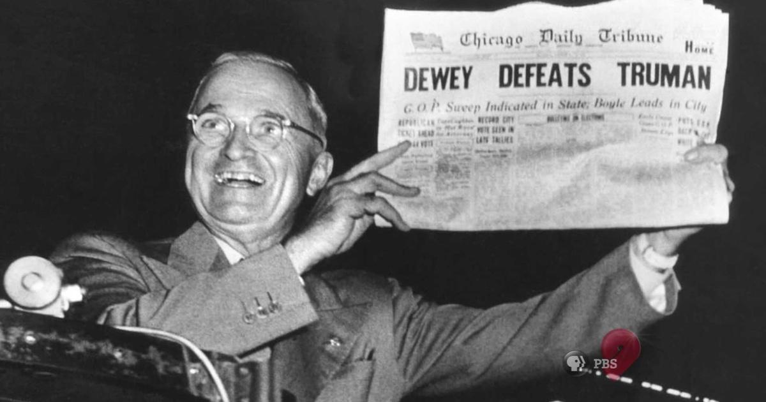
Mandatory Employee Vaccinations
Headline:
Employers Can Require Employees To Receive the Covid-19 Vaccine!

Slide 6
Mandatory Employee Vaccinations
The U.S. EEOC issued guidance on December 16, 2020 which acknowledges – at least tacitly – that Covid-19 vaccination programs are lawful

Slide 7
Mandatory Employee Vaccinations
But, there is fine print, on the back page…

Slide 8
Mandatory Employee Vaccinations – Exceptions
Employers must provide accommodations based on:
Disabilities (ADA)
Religious beliefs (Civil Rights Act – Title VII)

Slide 9
Disability Accommodations
Disability Accommodations (ADA)
Employers must provide reasonable accommodations to employees with disabilities that prevent them from safely receiving a Covid-19 vaccination

Slide 10
Disability Accommodations
What kinds of disabilities will qualify? Potentially:
Immune-compromised conditions (e.g., employees receiving chemotherapy treatments)
Allergies activated by the vaccine
Contraindications identified by vaccine manufacturers
Anxiety – coupled with fear of needles?

Slide 11
Disability Accommodations
Some employees will probably not be able receive the vaccination because of their medical conditions.
So…then what?
Exclude the employee from the workplace?
Remote work?
Termination?
Maybe none of the above – so proceed slowly.

Slide 12
Disability Accommodations
Employers are required to provide accommodations to employees with relevant disabilities – but may exclude them from the workplace if:
They pose a direct threat to themselves or others
A direct threat is “a significant risk of substantial harm to the health or safety of the individual or others”

Slide 13
Disability Accommodations
The direct threat analysis is case-specific, and will not apply to every unvaccinated employee.
For example, these employees probably do not pose a direct threat:
Bus mechanic who works in the shop alone
Records or payroll specialist who works alone in Central Office
Counselor working remotely

Slide 14
Disability Accommodations
Factors to consider when making the direct-threat analysis (according to the EEOC):
The duration of the risk
The nature and severity of potential harm
The likelihood that the potential harm will occur
The imminence of the potential harm

Slide 15
Disability Accommodations
Employers can consider the risk the unvaccinated employee poses to students and other employees…
…but can employer consider the risk the employee poses to himself/herself ?
The EEOC’s ADA regulations say yes, generally, but the EEOC’s Covid-19 vaccination guidance does not address this question.
And if the risk is so great you would exclude the employee, why are you not excluding all unvaccinated students? What is the difference?

Slide 16
Disability Accommodations
If employer concludes that the unvaccinated employee poses a direct threat to himself/herself or others, the employer can exclude the employee from the workplace.
But this alone is not grounds for termination.
Employer must also consider whether:
The employee can be accommodated in manner that allows the employee to perform the essential functions of his/her job (e.g., remote work)
The employee has other bases for leave (e.g., FMLA, FFCRA)

Slide 17
Disability Accommodations
If the employee can continue performing his/her job remotely, this is probably the easiest option, at least until the Fall.
In the Fall, it will be easier for schools to argue that remote work presents an undue burden for the school (which may, in that circumstance, allow for termination).

Slide 18
Other ADA Issues
Employers should follow the “interactive process” when determining whether employees need accommodations – and document the process accordingly
Employers can ask for proof of vaccination from employees (and should ask employee before contacting doctor)
Vaccine-related documents should be kept in employees’ “medical files” (not their “personnel files”)

Slide 19
Religious Accommodations
Religious Accommodations (Title VII)
Employers must provide reasonable accommodations to employees with religious objections to receiving the Covid-19 vaccination

Slide 20
Religious Accommodations
What kinds of religious objections require accommodations?
Any kind based on “sincerely held” religious
beliefs,
practices, or
observances

Slide 21
Religious Accommodations
Employers can require employees to validate, in writing, that:
The relevant religious belief they exert is in fact “sincerely held”
The religious belief applies to the Covid-19 vaccination program

Slide 22
Religious Accommodations
But employers do not have much basis for determining whether the religious belief really is sincerely held
Religious beliefs can be sincerely held even if:
They do not align with a major religion
They are inconsistent with the employee’s self-identified religion
The employee does not regularly attend a house of worship or otherwise engage in religious observances
This creates a VERY low threshold for the employee to assert a religious exception

Slide 23
Religious Accommodations
But – employers can deny vaccination exemptions based on:
Political beliefs (“I don’t trust this Trump/Biden vaccine”)
Cultural beliefs (“I don’t believe in vaccines”)
Scientific beliefs (“I don’t think this vaccine will work”)

Slide 24
Religious Accommodations
Employers do not have to allow employees to exempt themselves from the vaccination program based on their religious beliefs if this would impose an undue burden on the workplace
This undue burden analysis resembles the direct threat analysis under the ADA
Employers should consider the health and safety risks presented to this and other employees if this employee reports to work without receiving the vaccine

Slide 25
Religious Accommodations
If employer concludes that the unvaccinated employee poses an undue burden on the workplace, the employer can exclude the employee from the workplace.
But this alone is not grounds for termination.
Employer must also consider whether:
The employee can be accommodated in manner that allows the employee to perform the essential functions of his/her job (e.g., remote work)
The employee has other bases for leave (e.g., FMLA, FFCRA)

Slide 26
Religious Accommodations
If the employee can continue performing his/her job remotely, this is probably the easiest option, at least until the Fall.
In the Fall, it will be easier for schools to argue that remote work presents an undue burden for the school (which may, in that circumstance, allow for termination)

Slide 27
Should Employers Require Covid-19 Vaccines?

Slide 28
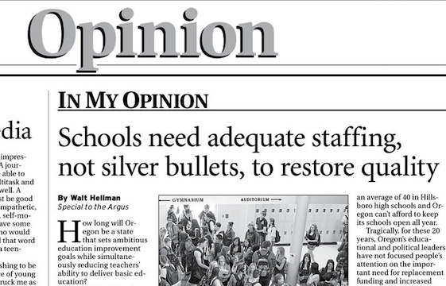
Voluntary Vaccination Programs
Opinion:
Employers can require employees to receive the Covid-19 vaccine – but should they?

Slide 29
Voluntary Vaccination Programs
Given the disability and religious accommodations required, schools should consider whether they would be better served with a voluntary vaccination program (“strongly encouraged” rather than “mandatory”)
Pros (Craig)
Cons (Micah)

Slide 30
Questions

Slide 31
Questions
Letters to the Editor:
What Questions Do You Have?

